Slide 1
Installation
MIS 634
Business Intelligence & Data Integration - LAB

Slide 2
Erwin data Modeler Installation Process:
Apply for an academic license using your email address：https://www.erwin.com/register/129709/.
Follow the instructions sent to your email to open a ticket for a license key. (This step takes a day. The key is going to work for a year.)
Download “erwin Data Modeler 2020 R2”. This software only works on windows. If your machine has any other operating system, you need to create a Windows virtual machine to be able to install the software.
Click to open the downloaded file and follow the steps in the setup wizard.
Enter the License key from your email when prompted.
Restart your computer.

Slide 3
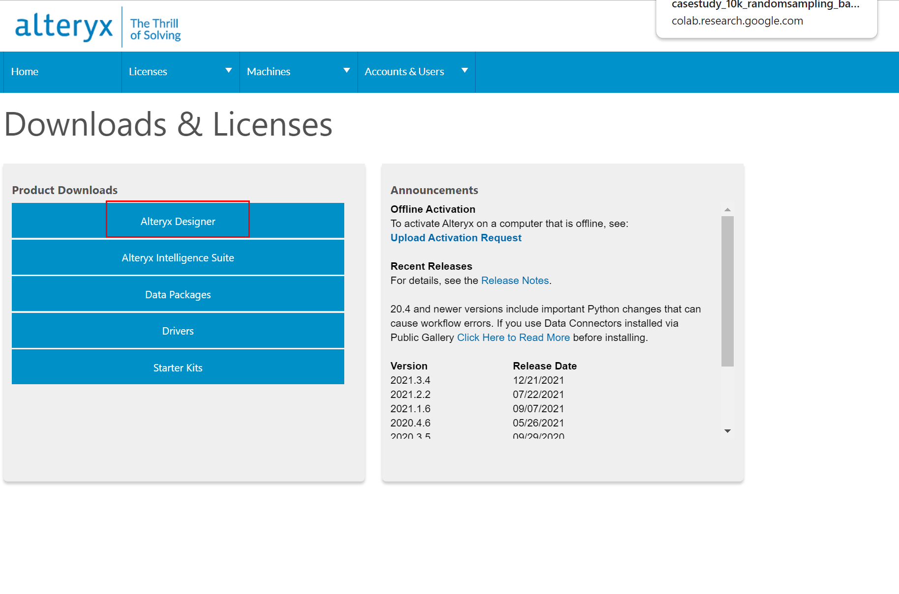
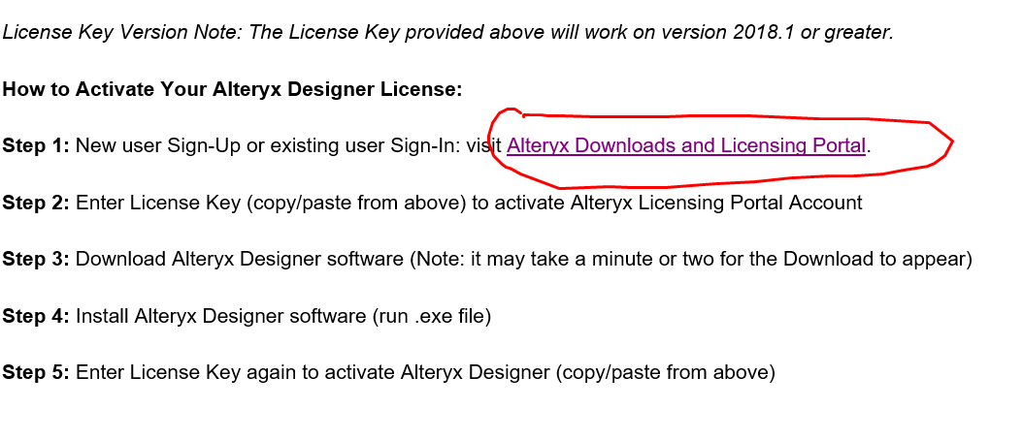
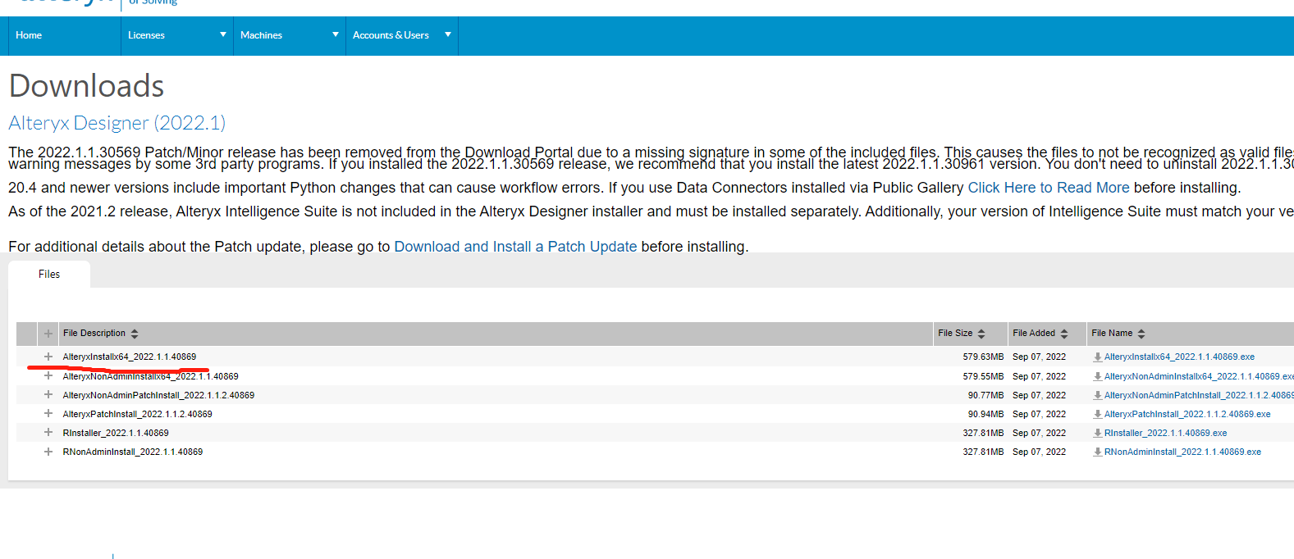
Alteryx Designer Installation Process:
Apply for a student license in their website： https://www.alteryx.com/designer-trial/free-trial-alteryx#New%20Users
After receive the license, click the link enclosed in the email to create your account: https://my.alteryx.com/licensing
In Product Download panel click on “Alteryx Designer”.
3. Download .exe file and install it.

Slide 4
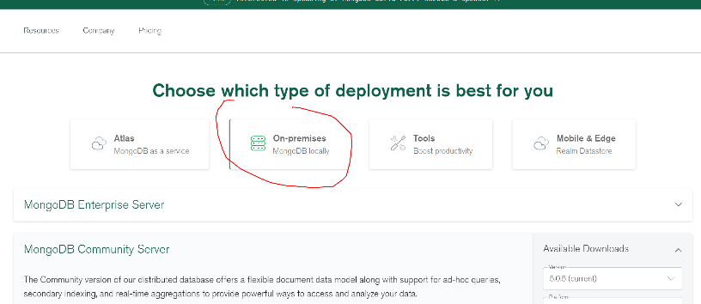
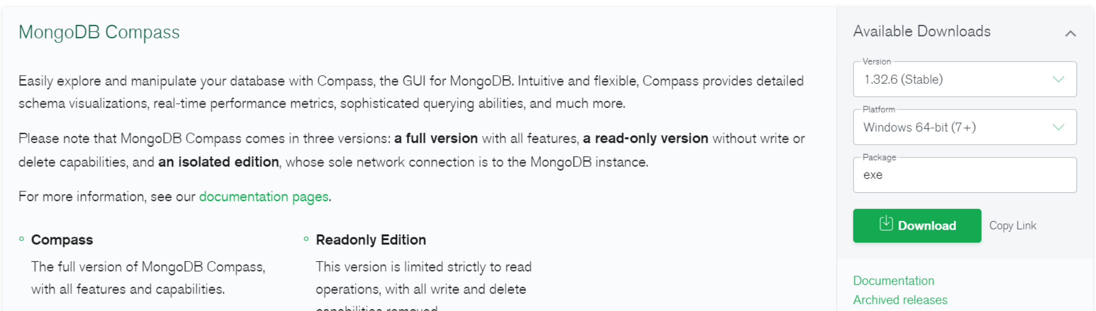
MongoDB Installation Process:
Download Community Server on-premises (https://www.mongodb.com/try/download/community).
Follow the installation Wizard steps. Choose： to install as a service when prompted.
Download MongoDB compass: https://www.mongodb.com/try/download/compass

Slide 5
Tableau Installation Process:
Apply student license in Tableau website:
https://www.tableau.com/community/academic
You will receive an email with instruction and the license code
Download the “Tableau Desktop” via the link in the email
Follow the instruction and install it

Slide 6
Installing Windows 10 on MacOS: For those students who have a Mac device, you need to install Windows 10 on your machine to install Erwin and Alteryx. Stevens provides Windows 10 Education edition free of charge for you. You can follow the instructions in https://sit.teamdynamix.com/TDClient/1865/Portal/KB/ArticleDet?ID=61146, to get your copy of Windows 10 and set it up using Boot Camp.
Hanlon Lab Computer:
Available Machine:
HFSL-HANLON-08.fsc.stevens.edu
HFSL-HANLON-09.fsc.stevens.edu
HFSL-HANLON-11.fsc.stevens.edu
HFSL-HANLON-12.fsc.stevens.edu
HFSL-HANLON-13.fsc.stevens.edu
HFSL-HANLON-14.fsc.stevens.edu
HFSL-HANLON-15.fsc.stevens.edu
HFSL-HANLON-16.fsc.stevens.edu
HFSL-HANLON-17.fsc.stevens.edu
Calendar: https://fsc.stevens.edu/hanlon-lab-calendar/

Slide 7
Rent a Windows Virtual Machine on Google Cloud Platform (GCP):
300 dollars as gift for each new account
Create Windows VM in Google Cloud under 5 minutes: https://www.youtube.com/watch?v=p5wl1s5gKY0
Install Chrome in Windows VM: https://cloud.google.com/architecture/chrome-desktop-remote-windows-compute-engine

